Slide 1

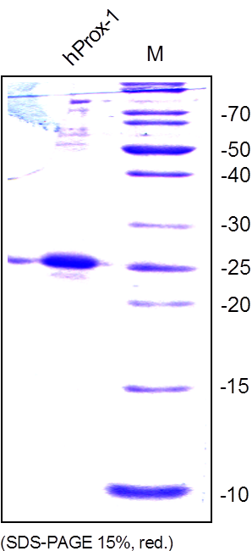
Reliatech GmbH
Recombinant human Prox-1 (fragment)
(Cat# 300-052)
Fig. 1: SDS-PAGE analysis of recombinant human Prox-1 fragment produced in E. coli. Samples was loaded in 15% SDS-polyacrylamide gel under non-reducing conditions and stained with Coomassie blue.
http://www.reliatech.de / orders@reliatech.de

